Slide 1

I Quit
Attrition Analysis With Python
Raviteja Bodla

Slide 2
Introduction
Employee turnover is not only a cumbersome process but also a financial burden. Employers can benefit from knowledge of an employee's likelihood of changing the company. Often, decisions for leaving a company do not emerge out of a sudden but are usually the outcome of careful pre-planning. Utilising a data-driven approach to analyse which employees are likely to leave the company soon, therefore, can be of great interest to managers. With the gained knowledge, human resource management teams can act upon these predictions to persuade employees to stay before they jump ship. The main aim of this study is to analyse different factors leading to employee attrition.

Slide 3
Dataset
The dataset is part of a Kaggle challenge and consists of 10 variables being a mixture
of numerical and categorical variables. Below Table depicts the individual features, their mean and
standard deviation as well as categorical features and a target variable “Left” which consists of the
two classes stay and leave. Furthermore, this dataset has ≈ 15.000 samples with a class imbalance
of 11428 (stayed) and 3571 samples corresponding to “left”.
…
S.no | Attribute | Type
1 | Satisfaction Level | Numerical
2 | Last Evaluation | Numerical
3 | Number of Projects | Numerical
4 | Avg. Monthly Hours | Numerical
5 | Time Spend Company | Numerical
6 | Work Accident | Numerical
7 | Promotion last 5 Years | Numerical
8 | Sales (10 Levels) | Categorical
9 | Salary(low, med, high) | Categorical
10 | Left | Categorical

Slide 4
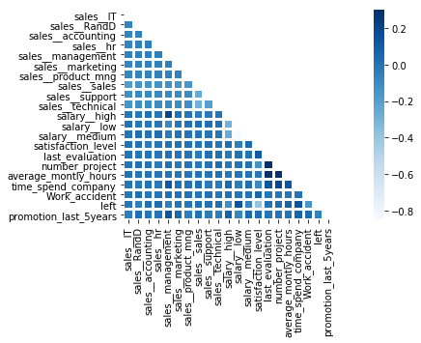
Correlation Heatmap

Slide 5
Correlation Summery
The correlation heat map displays the correlation between features themselves and the target variable.
Moderate Positively Correlated Features:
Avg Monthly Hours Vs Project Count : 0.417211
Last Evaluation Vs Project Count: 0.349333
Avg Monthly Hours Vs Last Evaluation: 0.339742
Moderate Negatively Correlated Features:
Attrition Vs Satisfaction: -0.388375

Slide 6
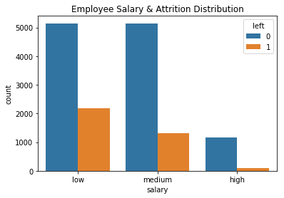

Salary Vs Attrition
Majority of employees who left either had medium or low salaries
Barely any employees with High Salary left.

Slide 7
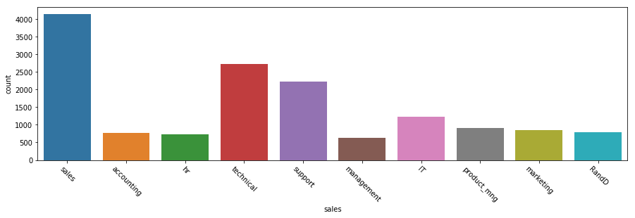
Employee Count Per Department

Slide 8
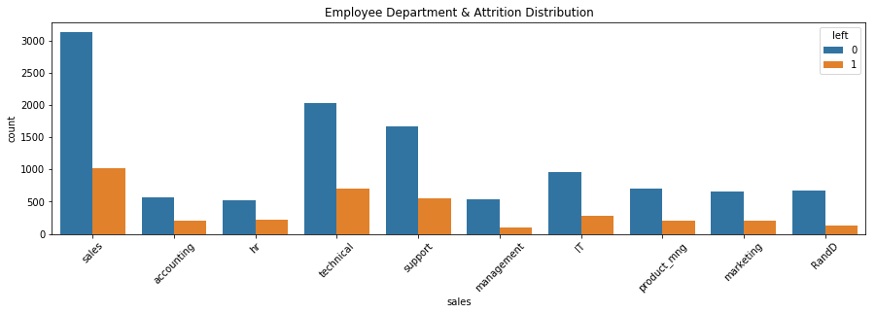
Department Vs Attrition

Slide 9
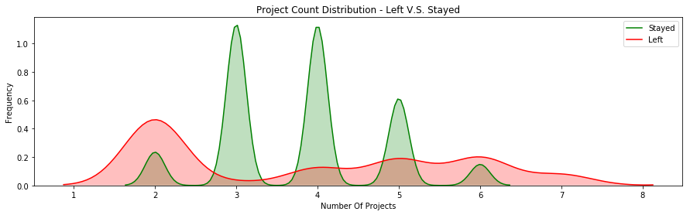
Project Count Vs Attrition

Slide 10
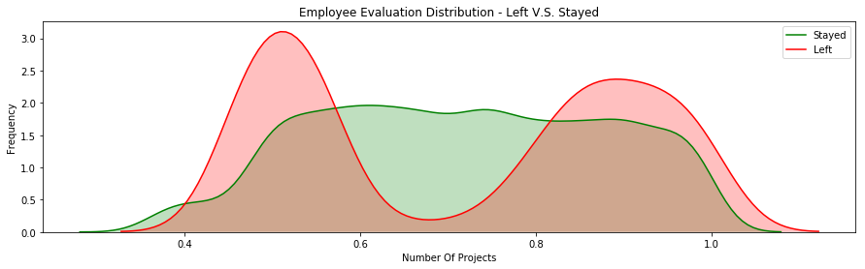
Evaluation Vs Attrition

Slide 11
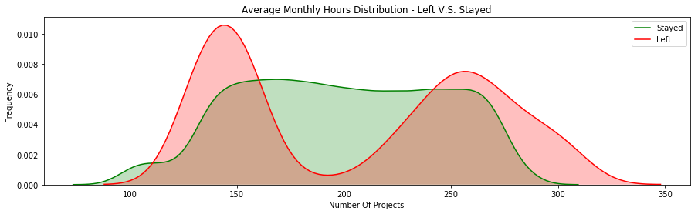
Average Monthly Hours Vs Attrition

Slide 12
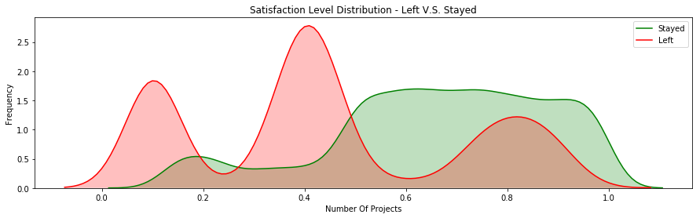
Satisfaction Level Vs Attrition

Slide 13
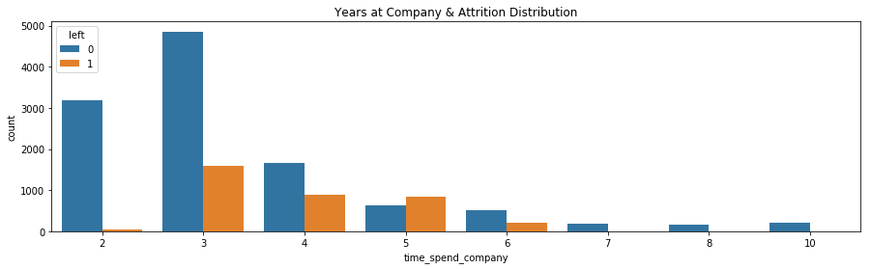
Years at Company Vs Attrition

Slide 14
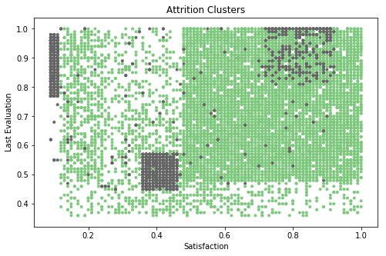

Slide 15
Summary
Employees generally left when they are underworked (less than 150hr/month or 6hr/day)
Employees generally left when they are overworked (more than 250hr/month or 10hr/day)
Employees with either really high or low evaluations should be taken into consideration for high attrition rate
Employees with low to medium salaries are the bulk of employee attrition
Employees that had 2,6, or 7 project count are at risk of leaving the company
Employee satisfaction is the highest indicator for employee attrition.
Employee that had 4 and 5 yearsAtCompany should be taken into consideration for high attrition rate
Employee satisfaction, yearsAtCompany, and evaluation were the three biggest factors in determining attrition.

